Slide 1
Customer Segmentation Analysis
Strategic Insights • Data-Driven Decision Making

Slide 2
Table of Content
Introduction
Workflow
Dashboard
Sales & Profit by Customer Segment
Top Regions and Cities by Revenue
Category and Sub-Category Contribution
Order Priority vs Profitability Correlation
Shipping Mode Analysis
Shipping Mode Impact on Profit Margins
Most Profitable Segments and Categories
Discount Impact on Sales & Profitability
Yearly and Quarterly Sales Trend
Customer Lifetime Value (CLV) Across Segments
Segment Performance Across Global Regions
Recommendations

Slide 3
Introduction
This project presents a comprehensive customer segmentation analysis built in Power BI, leveraging a real-world dataset to uncover strategic insights across segments, regions, product categories, and operational processes.
Through end-to-end data preparation, modelling, and visualization, the analysis identifies key drivers of revenue, profitability, customer value, and service efficiency, culminating in an interactive, decision-ready dashboard.
The objective of this work is to demonstrate capability in transforming raw data into actionable intelligence that supports commercial strategy, operational optimization, and customer-centric decision-making.

Slide 4




Workflow
Data Extraction
Data Modelling, Visualization
Data Cleansing, Analysis
Reporting and Recommendation

Slide 5
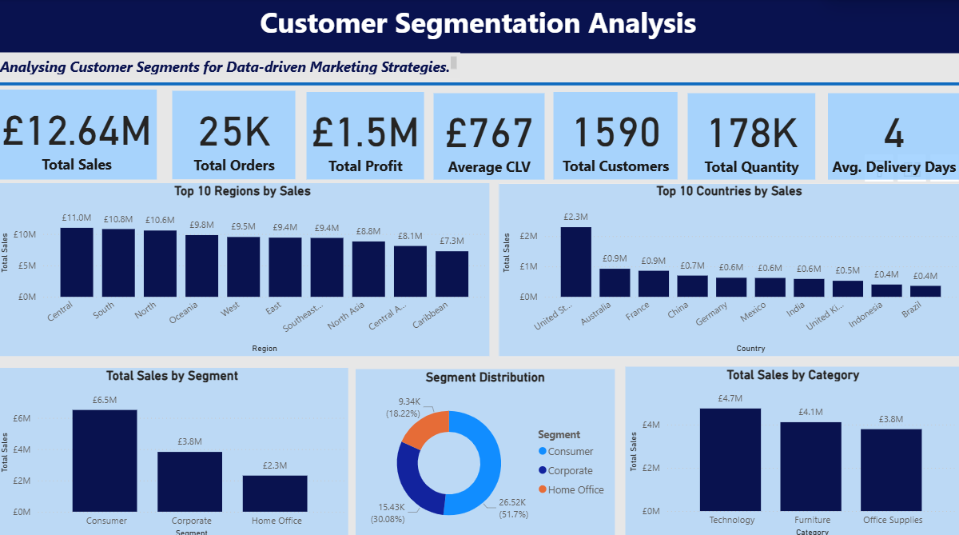
SUMMARY OF KEY INSIGHTS

Slide 6
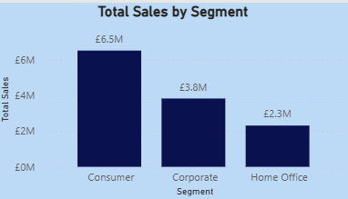
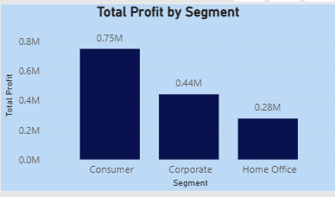
Sales & Profit by Customer Segment
The sales distribution shows a clear dominance of the Consumer segment:
Consumer: £6.5M is the largest contributor, accounting for most of the total revenue.
Corporate: £3.8M is a strong but secondary segment.
Home Office: £2.3M is the smallest revenue generator.
Consumer: £0.75M is the most profitable segment, representing the largest share of overall profit.
Corporate: £0.44M , moderate profit contributor; potential for targeted upselling.
Home Office: £0.28M is the lowest profit contributor, possibly due to smaller order sizes or higher discount sensitivity.
The Consumer Segment not only drives volume but is also financially strategic. Corporate remains a solid mid-level performer, while Home Office shows potential for targeted growth strategies such as tailored marketing or product bundling

Slide 7
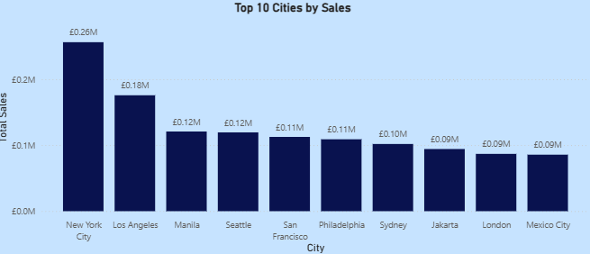
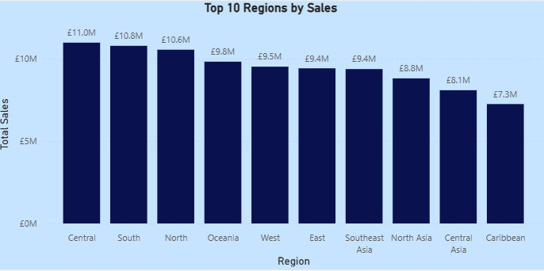
Top Regions & Cities by Revenue
The top city is New York with £256K in sales, across all segments, while the top region is the Central region accounting for 22% of total sales- £2.8M

Slide 8
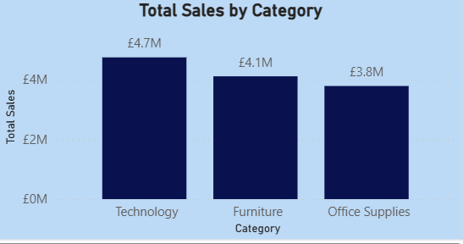
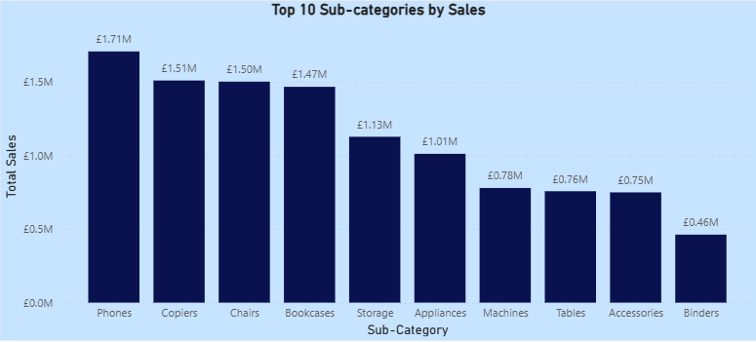
Category & Sub-Category Contribution
Technology is the largest contributor to across all segments, and accounts for 37% of total sales - £4.7M
Phones are the highest contributor to sales across all segments, accounting for 13% of total sales - £1.71M
Technology and Phones clearly have consistent customer demand, regardless of whether the buyer is Consumer, Corporate, or Home Office

Slide 9
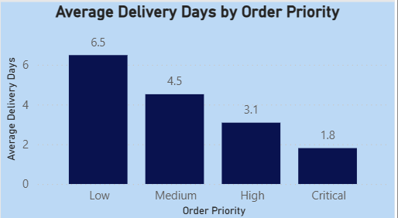
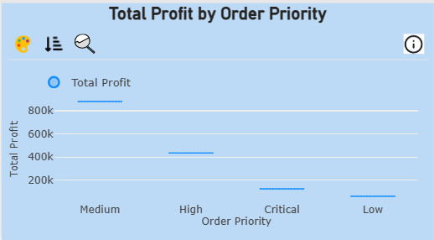
Order Priority vs Profitability Correlation
Delivery speed aligns strongly with order priority. Critical orders are fulfilled in under 2 days on average, while low-priority orders take over 6 days. The system effectively prioritizes urgent orders
Medium-priority orders generate most of the total profit, contributing more than all other priority levels combined. High-priority and Critical orders also contribute positively, while Low-priority orders generate minimal profit.
Technology has the highest concentration of Medium-priority orders, it appears across all priority levels, indicating that Technology products serve a wide range of customer needs, from urgent business-critical purchases to low-urgency consumer orders.

Slide 10
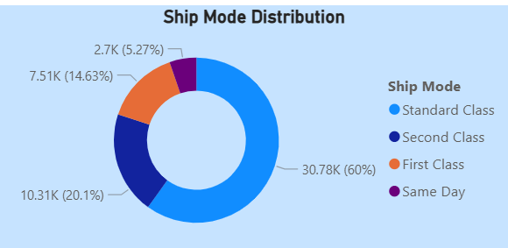
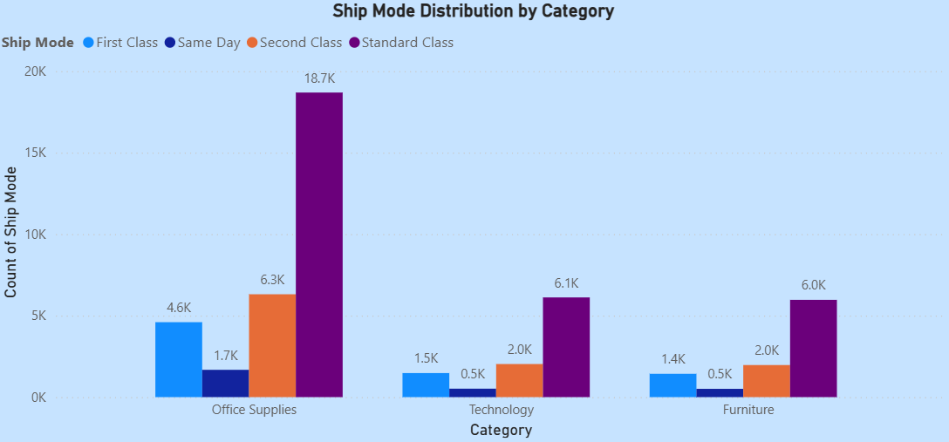
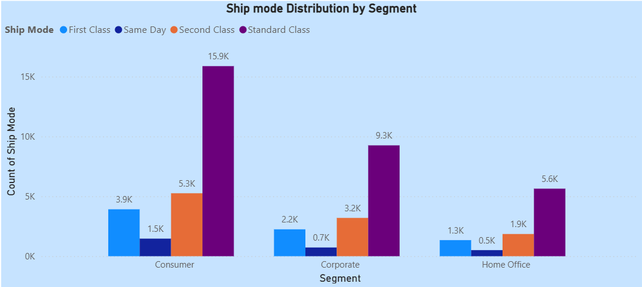
Shipping Mode Analysis
Standard shipping accounts for 60% of all orders, making it the most widely used ship mode.
Every Category relies heavily on standard shipping: Office Supplies, Technology, and Furniture all show their highest shipment volumes under Standard Class.
Office Supplies show the highest shipping counts across all modes; Standard, Second Class, First Class, and even Same Day.

Slide 11
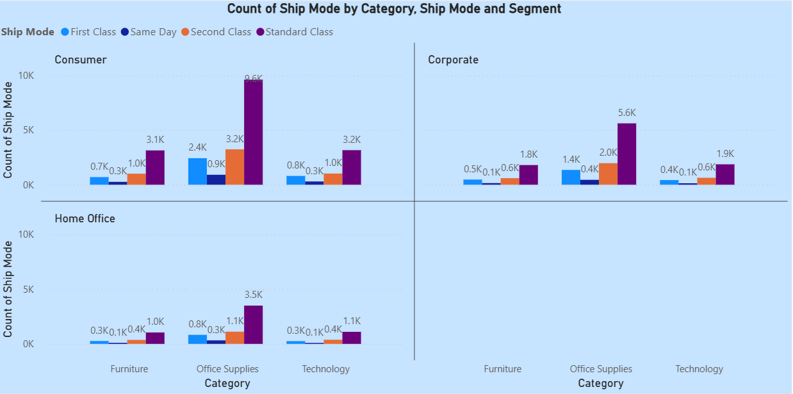
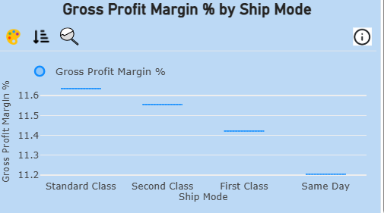
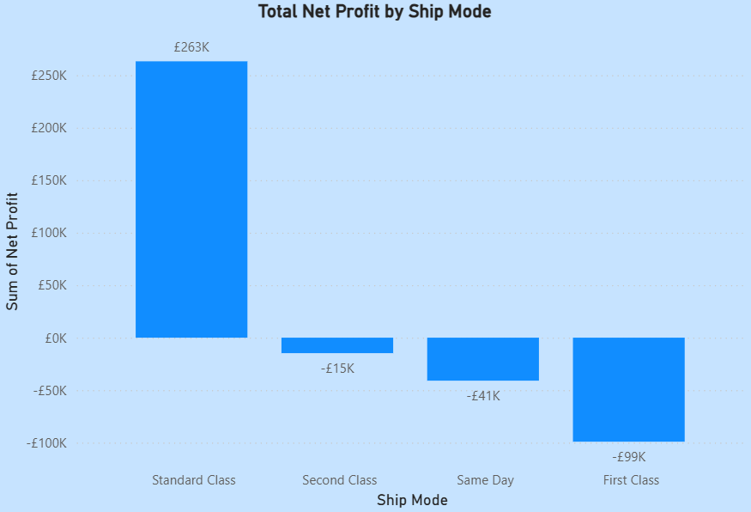
Shipping Mode Impact on Profit Margins
Gross profit is consistent across shipping methods, Standard 11.6%, Second 11.58%, First 11.4%, Same Day 11.2%, showing that faster shipping has minimal impact on profitability. Standard shipping not only leads in volume but also drives most of the net profit at £263K.

Slide 12
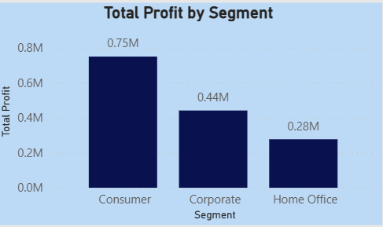
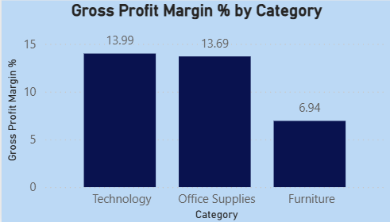
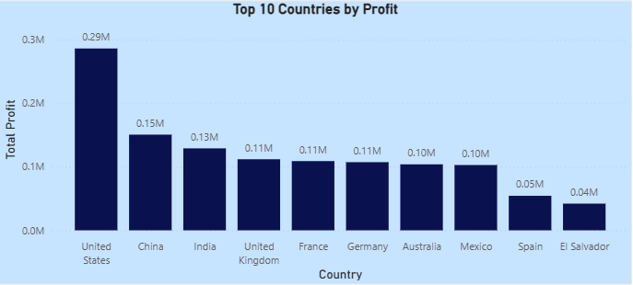
Most Profitable Segments / Categories
United States is the most profitable country across all segments.
The most profitable segment is the Consumer segment contributing £750K to Total Profit.
Technology contributes the most to profit across all segments

Slide 13
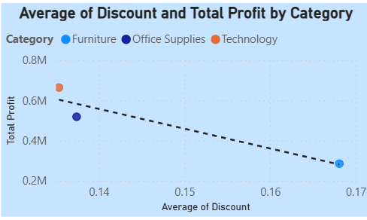
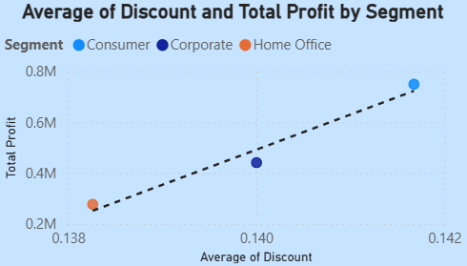
Discount Impact on Sales & Profitability
For Category:
Higher average discounts are linked with lower total profit.
This is evident as Furniture has the highest discount (0.17) and the lowest profit (£0.28M), while Technology has the lowest discount (0.13) and the highest profit (£0.66M).
For Segment:
Higher average discounts correlate with higher profit.
This is shown by Consumer having the highest discount (0.142) and highest profit (£0.75M), while Home Office has the lowest profit (£0.28M) and lowest discount.

Slide 14
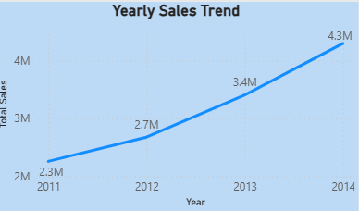
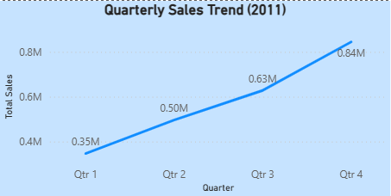
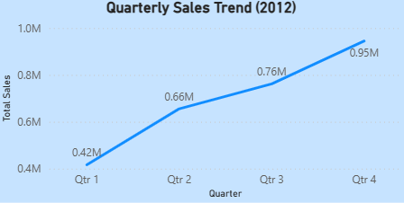
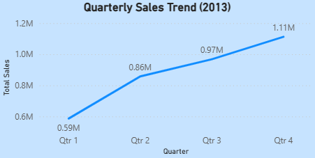
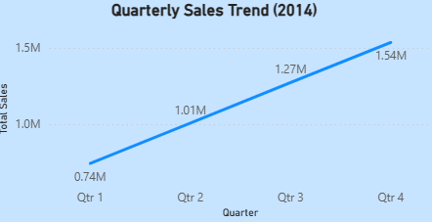
Yearly/Quarterly Sales Trends
Sales increased steadily from £2.3M in 2011 to £4.3M in 2014, showing a near-doubling of revenue within just four years.
Across all four years, Q4 repeatedly delivers the highest sales, with values rising from £0.84M in 2011 to £1.54M in 2014.
All quarters in 2014 outperform the same period in previous years. Q3 and Q4 2014 show particularly strong performance, reaching £1.27M and £1.54M respectively.

Slide 15
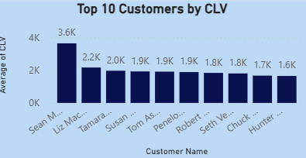
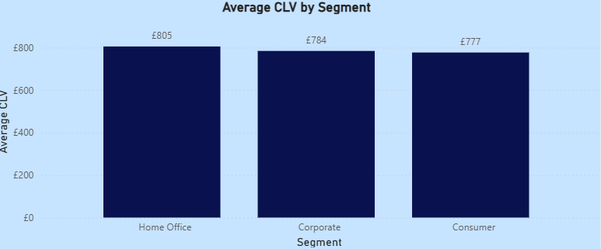
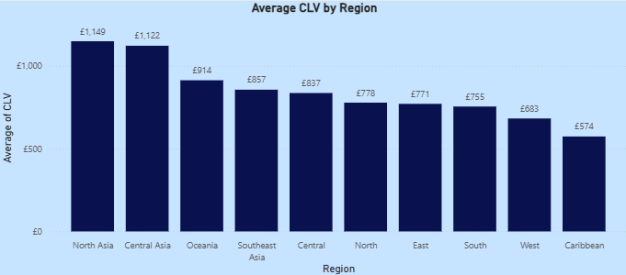
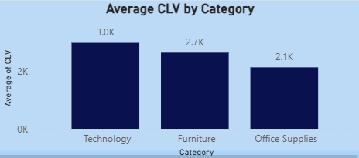
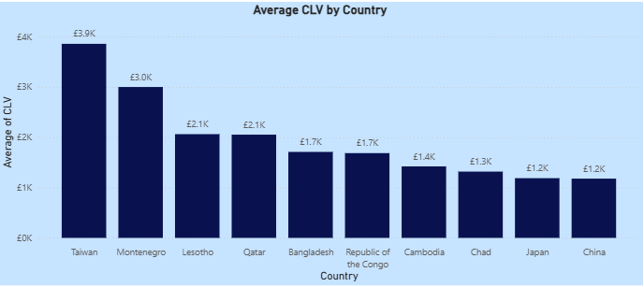
Customer Lifetime Value (CLV) Across Segments
Customer lifetime value (CLV) is the total revenue a business can expect from a single customer throughout their entire relationship.
There is a clear top performer, with the highest customer CLV at £3.6K, significantly above the rest, and worth 65% more than the second-highest customer.
Home Office has the highest CLV £805, followed by Corporate £784 and Consumer £777.
North Asia and Central Asia stand out with CLV above £1,100, substantially higher than all other regions.
Technology leads with £3.0K CLV, followed by Furniture £2.7K and Office Supplies £2.1K.
The spread between highest and lowest categories is significant with 43% difference.
Taiwan and Montenegro are exceptionally high-value markets, with CLV around £3.9K and £3.0K.

Slide 16
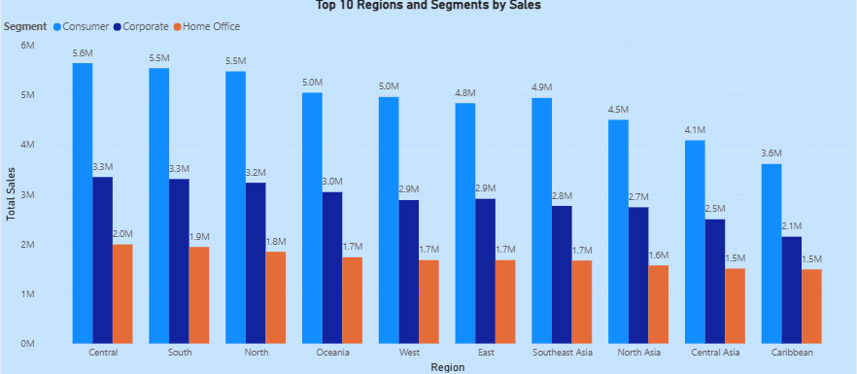
Segment Performance Across Global Regions
Central is by far the highest-performing region across all segments.
The Consumer segment consistently delivers the highest sales in every region.
Corporate is the middle performer across most regions.
Home Office contributes the lowest revenue in every region.
South and North Regions Are Strong Secondary Markets.

Slide 17
Recommendations
Strengthen Focus on High-Value Segments and Products: Consumer drives the highest sales at £6.5M and highest profit £0.75M. Expand targeted campaigns for Consumer buyers and develop loyalty programs that reward repeat technology purchases.
Increase Strategic Focus on Technology and phones: Technology is the largest revenue category £4.7M, and Phones are the top subcategory £1.71M. Increase product range, bundles, and cross-sell opportunities, and launch premium upsell programs (e.g., warranties, accessories).
Improve Profitability Through Smarter Discount & Priority Management: Reduce discounts in Low-Profit Categories such as Furniture. Optimize Order Priority Profit Structure by encouraging customers toward medium-priority orders through small incentives. Profitability can be maintained by reviewing costs associated with Critical/High priority orders.
Invest More in High-Performing Regions: Central with £2.82M sales (critical growth market), North Asia & Central Asia show industry-leading CLV >£1,100. Increase marketing spend and sales capacity here. For low performing regions (Caribbean, Canada, East, West), review fulfilment costs, competition levels, and pricing, and consider targeted micro-campaigns before committing large budgets.

Slide 18
Recommendations
Improve Shipping Profitability: Standard shipping represents 60% of all orders and delivers highest profit £263K. Encourage customers to choose Standard by highlighting savings and defaulting Standard as the pre-selected option in checkout.
Prioritize High-Value Countries for Expansion: Top CLV countries, Taiwan £3.9K and Montenegro £3.0K. Expand presence or partnerships in top CLV locations and increase region-specific marketing and promotions.
Leverage Q4 as a Peak Sales Period: Q4 is consistently the highest performing season. Front-load Q4 with major campaigns to increase sales. Expand inventory before Q4 to avoid shortages Also use YoY growth trends for forecasting as sales nearly doubled from £2.3M (2011) to £4.3M (2014).
Strengthen Pricing and Product Strategy for Home Office Segment: Home Office is the lowest-performing segment in both sales and profit. Reassess the Home Office product portfolio and conduct customer research to understand barriers to adoption.
Adopt City-Level Strategy: New York leads all cities £256K, far above the rest. Focus sales efforts on top metropolitan areas. Build city-specific campaigns (local events, citywide promotions).

